Slide 1
13/10/2015
Veronika Solilová, Danuše Nerudová
Proposal of transfer pricing rule for SMEs: case study of the Czech Republic
SAFE HARBOURS

Slide 2
Aim
to propose transfer pricing rules for SMEs in the context of their specificity in order to reflect sectoral and size-classes differences in the Czech Republic.
the project GA CR No. 15-24867S

Slide 3
Introduction
SME represent 99% of EU companies
Create 55%-75% of gross VA
89 mills jobs
Very low internalization (5% with foreign subs)
Obstacles
Not enough financial and human resources
Cannot bear the same administrative burden as LSEs
„one size fits all“ is not suitable

Slide 4
Theoretical Background
TP used as tax planning scheme – Swenson (2001); Bronson, Johnson and Sullivan (2010); Tierny, De Grave, Moore, Vandervelden, Matiheu (2009)
TP Guidelines (2010) – application of TP rules may be too complex for SMEs → a project to improve the administrative aspects of transfer pricing and compliance issues → revision of Section E on Safe Harbours
Compliance costs of taxation - Chittenden, Michaleas, Poutziouris (2000); Cresy (2000); Široký (1995); Nerudová, Bohušová, Svoboda a Široký (2009).

Slide 5
Methodology
TP should reflect both functions performed, risk assumed, assets used and used business model (manufacturer, distributor, services provider).
Dataset: two groups of SMEs from the Amadeus database:
SMEs (6,477 entities) with parent company in the Czech Republic and at least one subsidiary in Europe → selection of researched industry → NACE A, C, F, G, J, L and M
Independent SMEs (13,266 entities) from the selected NACE → analysis of indicators of profitability – PROFIT margin, EBIT margin
Profit or loss before taxation / Sales or Operating revenue * 100
Operating profit or loss / Sales or Operating revenue * 100

Slide 6
Methodology
Determination of profit margins or ranges – crucial in TP:
Interquartile change – 25th to 75th percentile
10 – 90 percentile
Period 2012-2014
Proposal of SME-specific transfer pricing rule → safe harbour:
Selected NACE
EU JTPF Guidelines on Low Value Adding Intra-Group Services (3-10%)
the proposed modifications to chapter VII of the OECD TP Guidelines relating to low value-adding intra-group services based on the BEPS action 10 (2-5%) and
Czech government Decree No. D-10 about low value-adding intra-group services (3-7%)

Slide 7
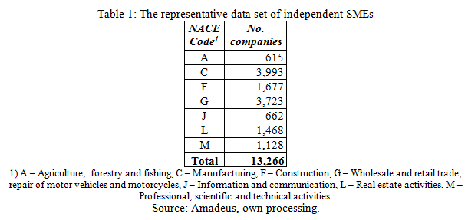
Results

Slide 8
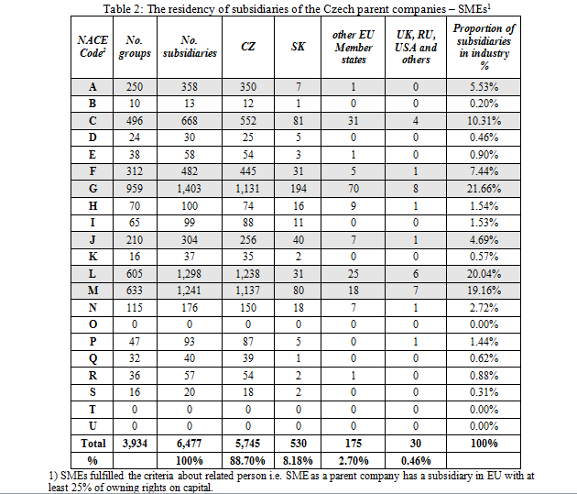
Results

Slide 9
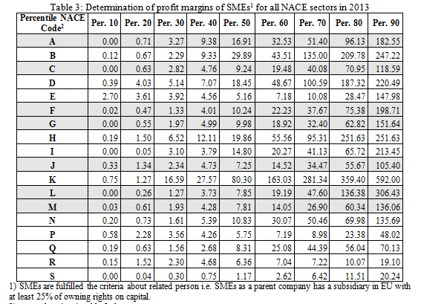
Results

Slide 10
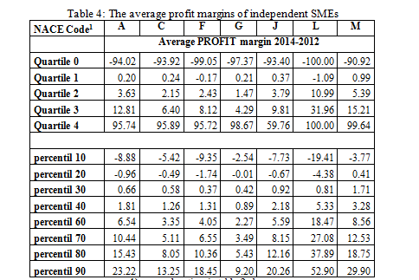
Results

Slide 11
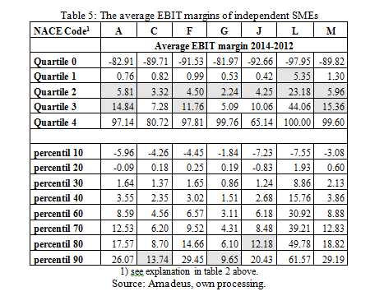
Results

Slide 12
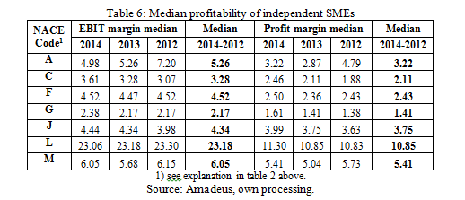
Results

Slide 13
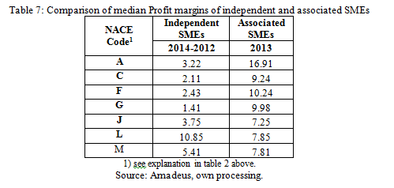
Results

Slide 14
Safe harbours
Results
3 currently effective Guidelines related to low value-adding intra-group services → SMEs should not apply lower EBIT margin for their core business activities in comparison with low value-adding intra-group services.
→ upper limit should be exceeding 10 percentage point
→ lower limit should be exceeding 2 percentage point
→ running between Q1, Q3, 80 or 90 percentile depending on whether the EBIT margin exceeded 2 and 10 percentage points

Slide 15
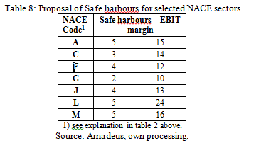
Results

Slide 16
Conclusion
The SMEs tax preferences or SME-specific tax rules is often justified by:
the special place of SMEs in the economy → employment, job creation and innovation.
in the respect of the transfer pricing issue SMEs bear disproportionally huge compliance cost of taxation mainly due to the lack of human and financial capital.
The proposed safe harbours was determined for the selected NACE sectors (NACE A, C, F, G, J, L and M) and ranging 2-24%.
It presents a few advantages for taxpayer and tax authorities.

Slide 17
Thank you for your attention !!
13/10/2015, Brno
Solilová and Nerudová Department of Accounting and Taxes
danuse.nerudova@mendelu.cz www.mendelu.cz

